Slide 1
Telenor Java Meetup MongoDB (part 1) by VLPO
04/07/2018

Slide 2
What is MongoDB?
- JSON -> BSON - Document oriented - Cross platform - Horizontal scaled
Official MongoDB UI CompaSS

Slide 3
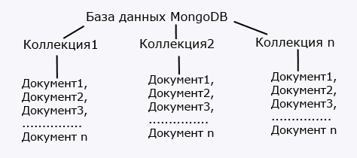
DB Structure

Slide 4
Document Structure
- Document consists of key/value pairs: {
"name": "Bill",
"surname": "Gates",
"age": "48",
"company": {
"name" : "microsoft",
"year" : "1974",
"price" : "300000"
}
}
Key “name” Value “Bill” Key “company”.”name” Value “microsoft”
Everything here is case sensitive and has strict type “28” != 28, “microsoft” != “Microsoft”
Each document has _id

Slide 5
INSERT INTO, SELECT
There are three method to make insert: insertOne(), insertMany(), insert()
db.users.insertOne({"_id": 123457, "name": "Tom", "age": 28, languages: ["english", "spanish"]})
db.users.insertMany([{"name": "Bob", "age": 26, languages: ["english", "frensh"]},
{"name": "Alice", "age": 31, languages:["german", "english"]}])
db.users.insert({"name": "Tom", "age": 28, languages: ["english", "spanish"]})
P.S. insertOne() and insertMany() returns objects _id fields of inserted records, insert() only returns inserted records number
P.S.S. It’s super easy to load data from dump just use load(<path_to_file>) method
- find(), findBy() SELECT * FROM Table WHERE Name='Tom' AND Age=32
equals
db.users.find({name: "Tom", age: 32})
db.users.find({name: "Tom“}, {age: 0, _id:false, languages:true})
db.users.find({"company.name": "microsoft"})
db.users.find ({age: {$lt : 30}}) $eq, $ne, $gt, $lt, $gte, $lte, $in, $nin
db.users.find ({name: "Tom", $or : [{age: 22}, {languages: "german"}]})
$or, $and, $not, $nor
Position? Easy! db.users.find({"languages.0": "english"}), index is starting from 0, luckily ☺
- .pretty() is awesome!

Slide 6
Save / Update / Delete
save() is _id dependent, return number of inserted OR updated records
update(query, newObj, options). Options upsert, multi
db.users.update({name : "Tom"}, {name: "Tom", age : 25}, {upsert: true})
$set, $unset
db.users.update({name : "Tom"}, {$unset: {salary: 1, age: 1}})
$push, $each, $position, $slice
db.users.update({name : "Tom"}, {$push: {languages: {$each: ["german", "spanish", "italian"], $position:1, $slice:5}}})
$pop, $pull, $pullAll
db.users.update({name : "Tom"}, {$pullAll: {languages: ["english", "german", "french"]}})
updateOne(), updateMany()
remove(query, multipleDeleteFlag)
db.users.remove({name : "Tom"}, true)

Slide 7
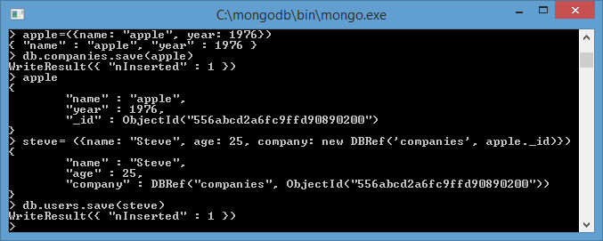
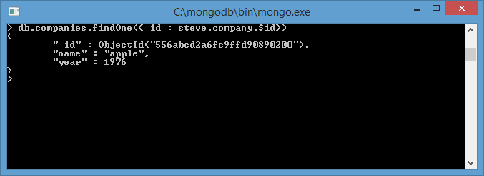
Linking entities together
apple=({"name" : "apple", "year": 1976})
db.companies.save(apple)
steve = ({"name": "Steve", "age": 25, company: new DBRef('companies', apple._id)})
db.users.save(steve)
db.companies.findOne({_id: steve.company.$id})

Slide 8
Indexing
createIndex({fields}, {“unique”:true/false})
db.users.createIndex({"name" : 1, "age" : 1}, {"unique" : true})
db.users.getIndexes()
db.users.dropIndex(<index_name>)

Slide 9
FIN

